Slide 1
SQL Server Encryption for Beginners
SQL Saturday South Island

Slide 2





THANK YOU TO OUR SPONSORS!!

Slide 3










Who am I and who are you?
Rob Douglas
Principal Consultant at DataSentinel
Many Years working with SQL Server

Slide 4
What We Will Cover?
An Introduction To Encryption
And Introduction To The 5 Types Of SQL Encryption
Object Encryption
Backup Encryption
Transparent Data Encryption (TDE)
Always Encrypted
Connection Encryption
Notes:
GDPR - 10M Euro or 2% of global revenue(not profit), or egregious violation 20M Euro or 4%. So we must show real verifiable effort.
Many American States have their own.
Cost of data breach settlements in the 10’s and 100’s of $

Slide 5
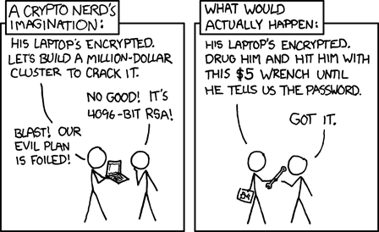

The Scary Slide
Notes:
List a few big breaches and what it cost the company.
https://www.toptenz.net/10-most-expensive-data-breaches-and-a-simple-trick-to-protect-your-website.php
https://www.cryptopia.co.nz/ - Make it personal – affects people in this city at this event.
Promise Encryption solves the problem.
BUT….
Show the cartoon
BUT…
General Data Protection Regulation(GDPR) says a bunch of things about what you can and can’t do. You can only collect data if there’s a business need to do it. can impose fines on data breaches, and those fines get bigger if you can be shown to have not made a reasonable effort to protect your data. ($10million Euro r 2% of worldwide revenue(not profit) - whichever is higher. Double if shown to be egregious violation. There needs to be a real verifiable effort.)
Data Breaches are bad - It’s your job to stop them. If you don’t you might get lucky and lose your job, but you might get unlucky and your company goes out of business and all your mates lose their job too.
So here’s where Encryption comes in.

Slide 6
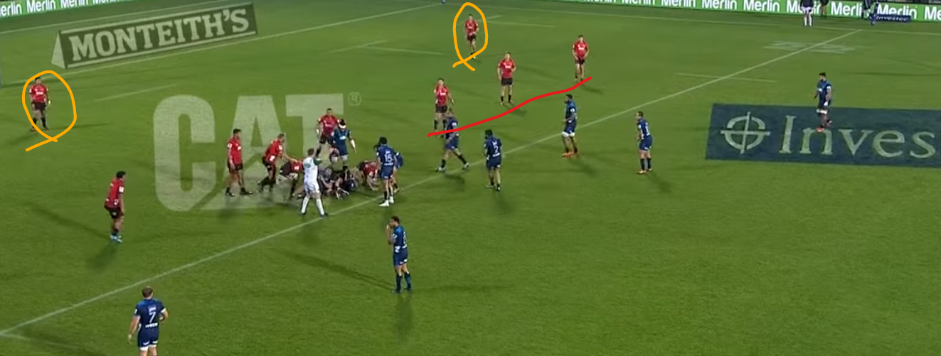
Defense In Depth
Notes:
Encryption is only part of a security plan - Rugby Analogy
Compare multiple layers of security to multiple layers of rugby team defense(Or league if more appropriate to Sydney). Point out that in this shot all of the defensive measures are bypassed by the fact the referee is in the process of awarding a penalty(ie the compliance\legal order can trump whatever you have in place – Snapchat story )

Slide 7
What is Encryption?
“Encryption is the process of encoding a message or information in such a way that only authorized parties can access it and those who are not authorized cannot... The intended information or message, referred to as plaintext, is encrypted using an encryption algorithm – a cipher – generating ciphertext that can be read only if decrypted.“
Wikipedia\Encryption
Notes:
In other words it’s the reversible obsfuscation of data.
Reversibility depends on a key
Only Part of your overall security plan. - Defense In Depth.

Slide 8
Object Encryption
Object Encryption(Not Really)
Available in all versions/editions of SQL Server
Just add WITH ENCRYPTION to object definition
Not really Encrypted - just Obfuscated
Can be decrypted by a malicious user with a small amount of effort
Notes:
https://sqlity.net/en/1617/decrypting-encrypted-database-objects/
A known plaintext attack against an encryption algorithm can be use when you have the ability to get you hand on a particular data set in the encrypted and the unencrypted form.

Slide 9
Object Encryption Demo

Slide 10
Backup Encryption
Introduced in SQL Server 2014
Available in Standard or Enterprise Edition
Encrypts Native Backup files
Based on a certificate stored securely within the SQL Server engine

Slide 11
Backup Encryption Demo

Slide 12
Transparent Data Encryption (TDE)
Introduced in SQL 2008 Enterprise Edition
Enterprise Edition Only until SQL 2019
Also based on certificate within the SQL Engine
Encrypts at rest
MDF, NDF, LDF files only
Server-side Encryption and Decryption
Notes:
https://www.sqlservercentral.com/blogs/rotating-tde-certificates-without-re-encrypting-data

Slide 13
Transparent Data Encryption Demo

Slide 14
Transparent Data Encryption (TDE) - Stuff We Learned
Encrypting any one database with TDE also encrypts TempDB
Restoring Backups requires the certificate
Can use TDE AND Backup Encryption
No blocking while encrypting
Best Practice is use separate certificates
Notes:
Then we have the certificate which is used to encrypt that key – without the certificate the key is useless and TDE can’t work. The certificate we keep a password protected backup of, so is a bit more vulnerable/public.
Due to that, certificates have an expiry date. This date is a reminder to us that, as a good practice, we should create a new certificate and use that going forward before the existing one expires. TDE doesn’t stop working if the certificate expires, it is up to you to monitor your certificates and replace them when they come to the end of their life.

Slide 15
Notes:
What did we just achieve? What am I protected against? What am I NOT protected against?
What do I do if I lose my certificate?
So – how does that apply to Azure Database? How does that apply to Managed Instance?

Slide 16
Always Encrypted\Column Encryption
Introduced in SQL 2016
Enterprise Only before SP1
Standard Edition with release of SP1
Encrypts Only Specific Columns
Application Side Encryption and Decryption
DBA can’t see data!
Certificate is installed on the application server
Notes:
Application accepts input and encrypts them - then sends a big VARBINARY to SQL - SQL just thinks there’s a bunch of varbinaries in the database.
Can’t do via TSQL - must be Management Studio or application
-Deterministic(Same values are encrypted to the same values)
-Randomized - everything is encrypted.

Slide 17
Always Encrypted Demo

Slide 18
Always Encrypted
Column Limitations - Constraints and Data Types
Deterministic vs Non-Deterministic
Blocking Operation while Encryption takes place
Certificate not managed by SQL Server

Slide 19
Connection Encryption
Available in all versions/editions of SQL Server
Encrypts data in flight
Client and server side Encryption/Decryption
Uses Secure Socket Layer (SSL)
Notes:
https://docs.microsoft.com/en-us/sql/database-engine/configure-windows/enable-encrypted-connections-to-the-database-engine?view=sql-server-2017
https://msdn.microsoft.com/en-GB/library/mt163865.aspx?f=255&MSPPError=-2147217396

Slide 20
Connection Encryption Demo
Notes:
Force Encryption
https://docs.microsoft.com/en-us/sql/database-engine/configure-windows/enable-encrypted-connections-to-the-database-engine?view=sql-server-2017

Slide 21
Certificates Maintenance
Back Up All Your Certificates
Keep them where they are Protected and Available(Safe and Secure)
Do Not Lose Your Certificates!
Remember that if you lose the certificate you lose your data!
Notes:
If you lose your certificates you have no comeback. You can’t have Microsoft come and solve this problem - you need to have a backup!

Slide 22
Questions

Slide 23
Questions?
Where Do We Store The Keys?
Does the Master Key need to be the same? No Just needs to be one.
Hw to disable TDE? Disable Encryption on atabase, Drop DEK, clear log(items in log file remain encrypted until you clear it)
How to decrypt TempDB? Remove all TDE databases and then restart SQL
SHould you use TDE or SAN Encryption? SAN if you trust it
Does TDE remove SAN deduplication\compression? Almost definitely
Compressions+TDE? Compression gets hit hard.
How does it affect Always On\Mirroring\Replication? Certificate must be on all servers.
Notes:
Where Do We Store The Keys?
Does the Master Key need to be the same? No - they just have to have one. Think of the master key as being a setting that is called “AllowEncryption”
Hw to disable TDE? Disable Encryption on Database, Drop DEK, clear log(items in log file remain encrypted until you clear it)
How to decrypt TempDB? Remove all TDE databases and then restart SQL
SHould you use TDE or SAN Encryption? SAN if you trust it\the person looking after it – that way you don’t lose SAN compression.
Does TDE remove SAN deduplication\compression? Almost definitely
Compressions+TDE? Compression gets hit hard.
How does it affect Always On? Certificate must be on all servers.
How does Always Encrypted effect SQL Replication?
How Does the client get the certificate?

